Slide 1

Generating a HDR image from an exposure sequence
CSE 4019 REVIEW -1
01

Slide 2



SUCINTHAR S
2
19BPS1025
TEAM MEMBERS
JARUN MADHESH
19BPS1076
Generating a
HDR image from an exposure sequence
ARAVIND J
19BPS1110

Slide 3
03
Abstract
Generating HDR image from a sequence of multi-exposure shots using different methods and evaluating them.

Slide 4
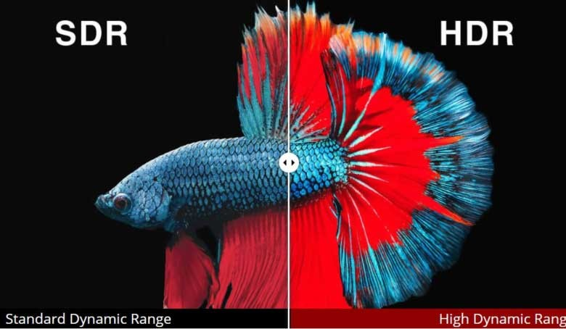
SDR vs HDR

Slide 5
HDR :
HDR stands for high dynamic range. Dynamic range is simply the range of the lightest tones to the darkest tones within a photo. Put another way — it’s a measure of the light intensities from the highlights to the shadows.
The higher dynamic range your camera has, the closer the photo will compare to what an eye can see. This means that you’ll be able to capture more details in the shadows that might otherwise appear pure black, and you’ll be able to see details in the highlights that might otherwise be washed out with white.

Slide 6
Type of HDR Imaging
1.Single exposure HDR Imageing
Users single LDR image to produce a HDR image
This is hard as we will not be having much details as either the under-exposed or over-exposed region.
With advent of CNN, single image HDR istaking a go.
2.Multi exposure HDR imaging
Uses sequence of multiple exposure LDR iamges.
This project focuses on multi image HDR. More on this
further....

Slide 7
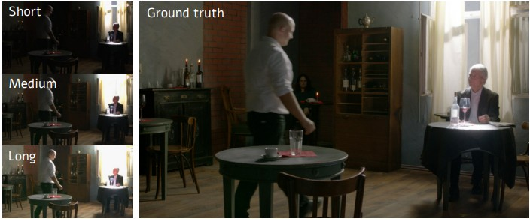

Slide 8
Challenges in multi- exposure HDR imaging
SInce this method uses a sequence of pictures, due to several factors like:
Camera movement Motion in scene Changing light sources
We could experince effects like: Ghosting and bleeding edge
Cartooning HDR Halos

Slide 9
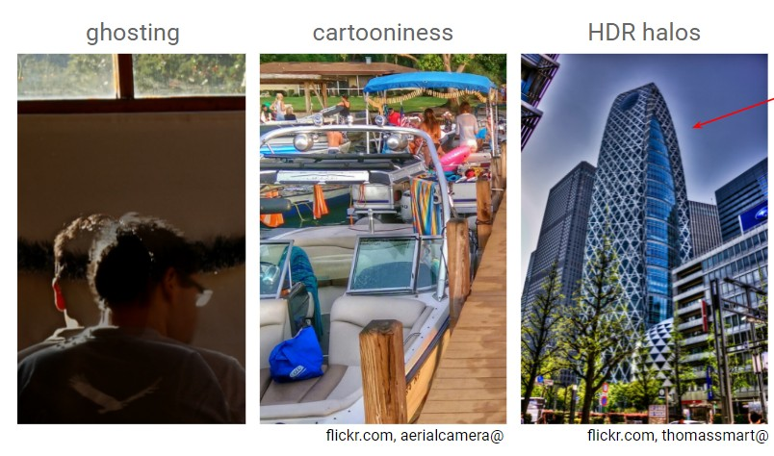

Slide 10
DATASET

Slide 11
Burst photography for high dynamic range and low-light imaging on mobile cameras Samuel W. Hasinoff, Dillon Sharlet, Ryan Geiss, Andrew Adams, Jonathan T. Barron, Florian Kainz, Jiawen Chen, and Marc Levoy
ACM Transactions on Graphics (Proc. SIGGRAPH Asia 2016), 35(6), 12 pp.
Total images in the dataset
3640 bursts with 28461 images in total. (764GB)
To start with, they suggest using the subset of bursts (153 bursts, 37 GiB) that they have curated. So, That would be the dataset we will b eusing for our project.

Slide 12
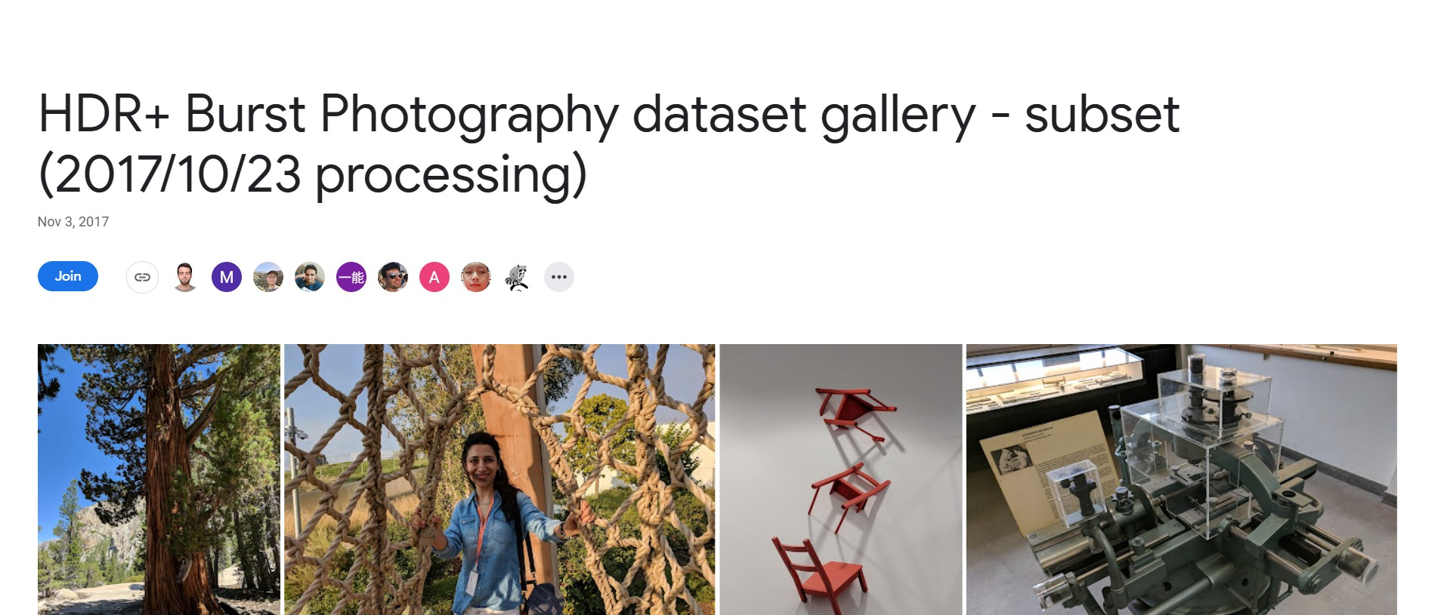

Slide 13
METHODS TO BE COMPARED

Slide 14
Few of most common methods used to generate HDR image:
Debevec method Robertson method Mertens fusion Reinhard Tonemap
and many more...

Slide 15
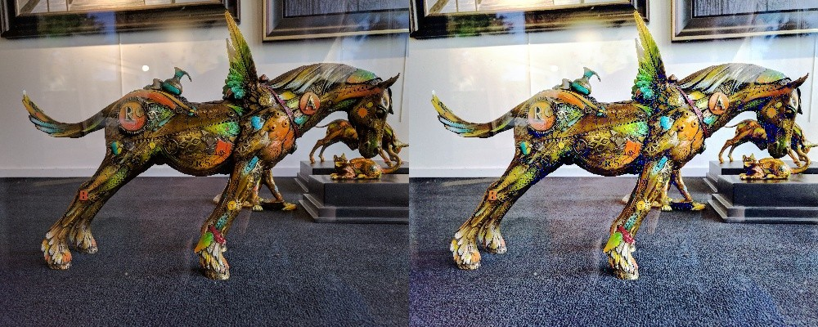
HDR image from proposed method

Slide 16
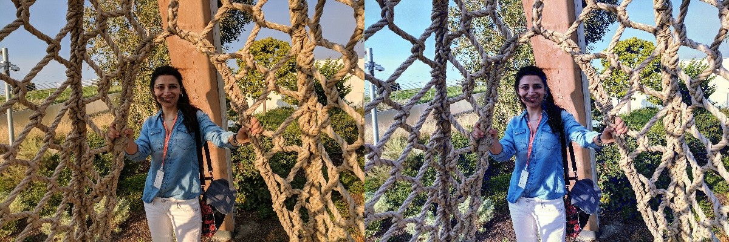
HDR image from proposed method

Slide 17
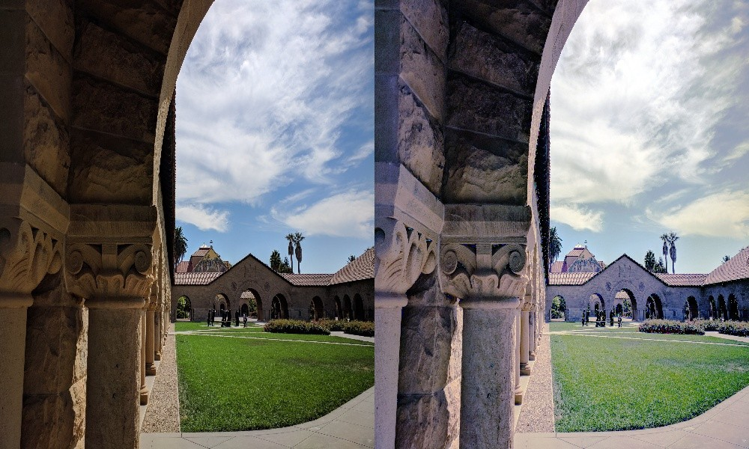
HDR image from proposed method

Slide 18
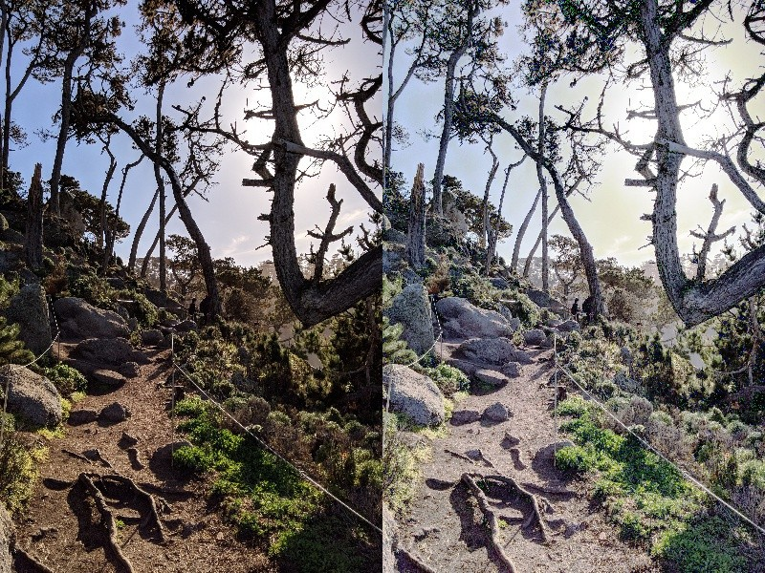
HDR image from proposed method

Slide 19
EVALUATION

Slide 20

We have analysed the different methods and compared it with our method for generating best HDR image.

Slide 21
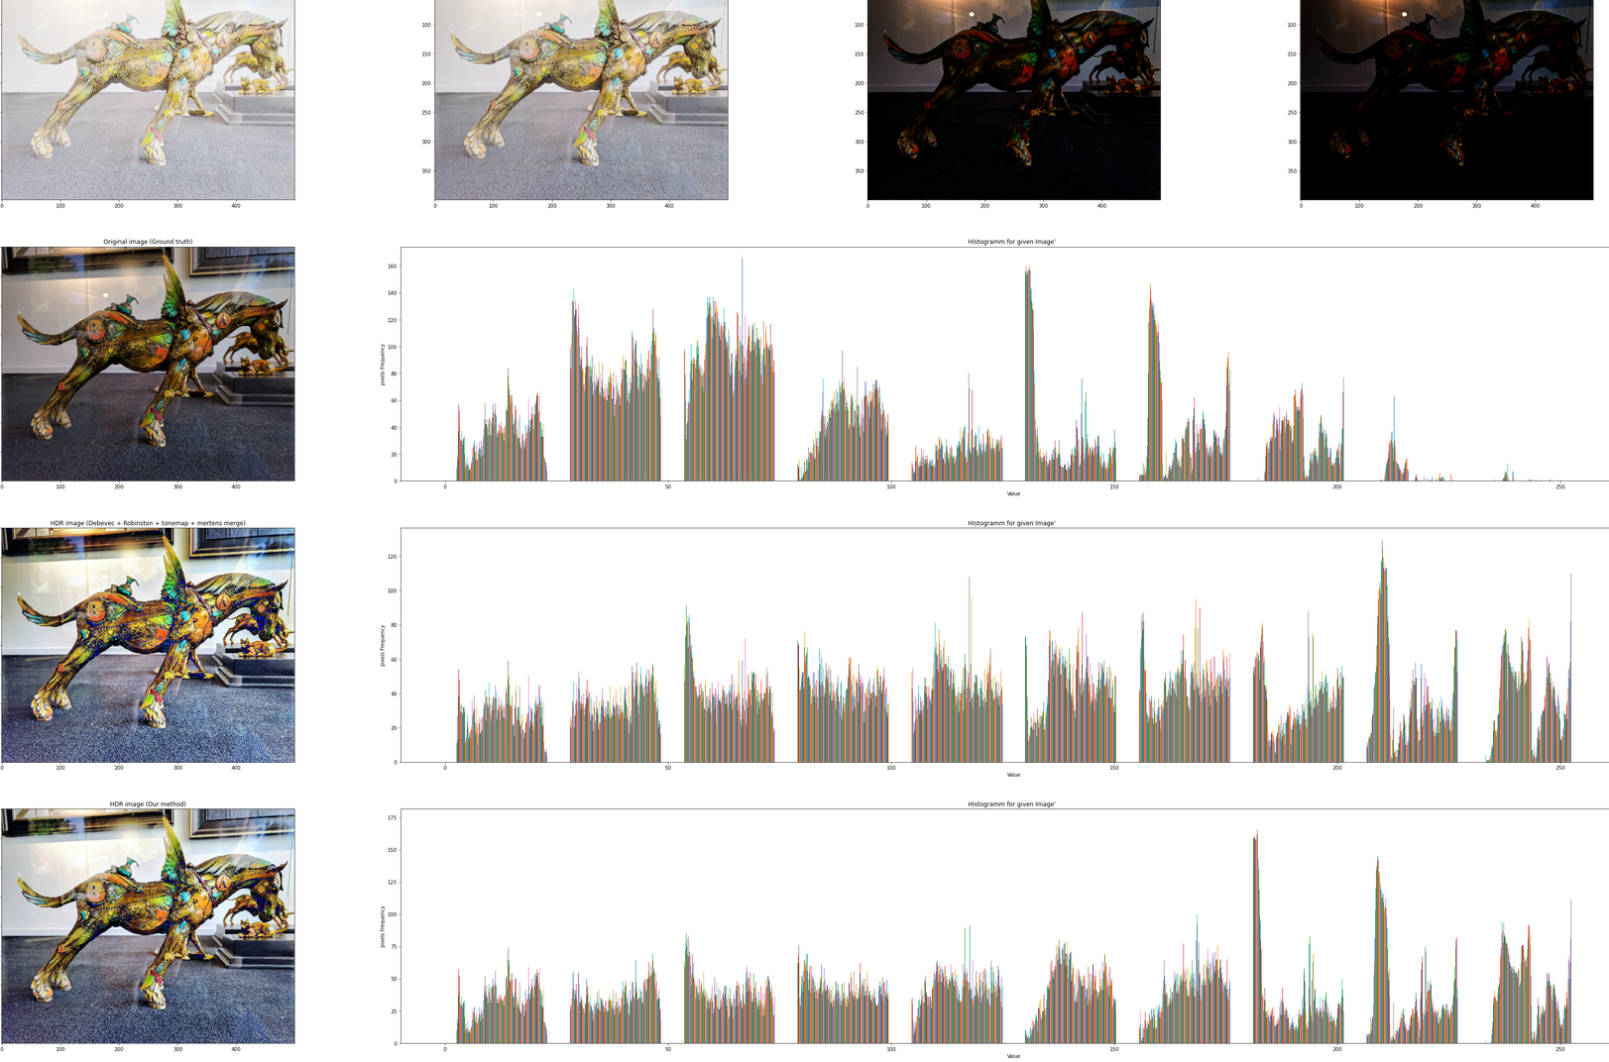
Evaluation with other methods

Slide 22
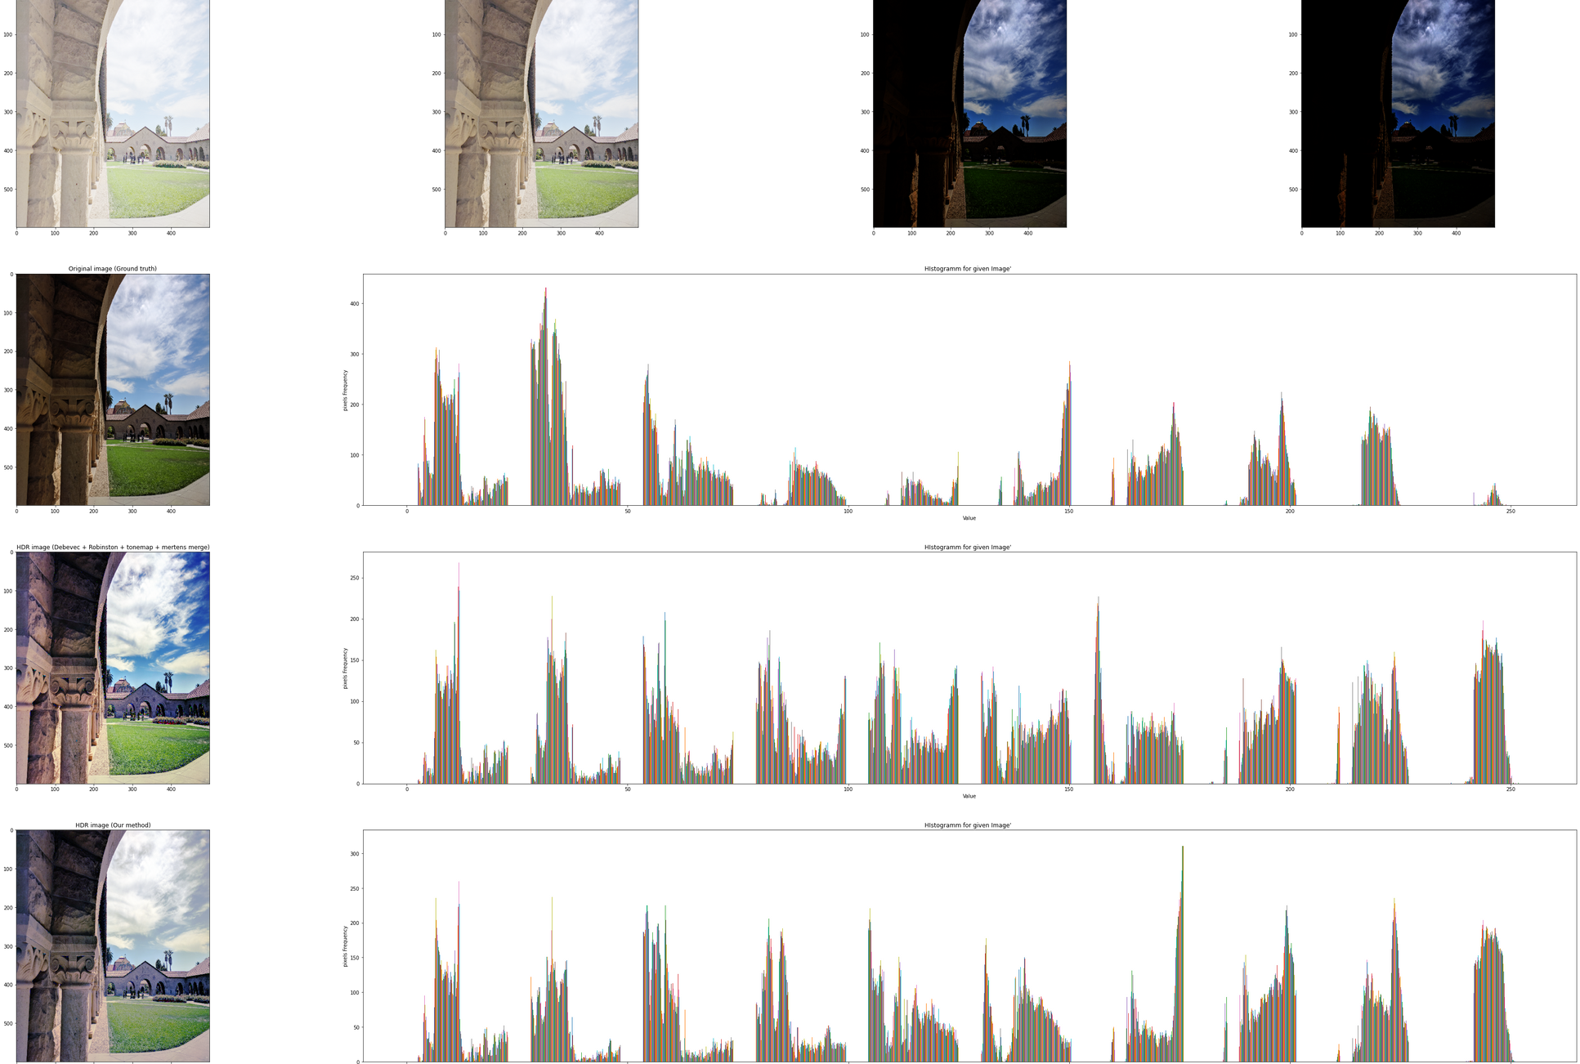
Evaluation with other methods

Slide 23
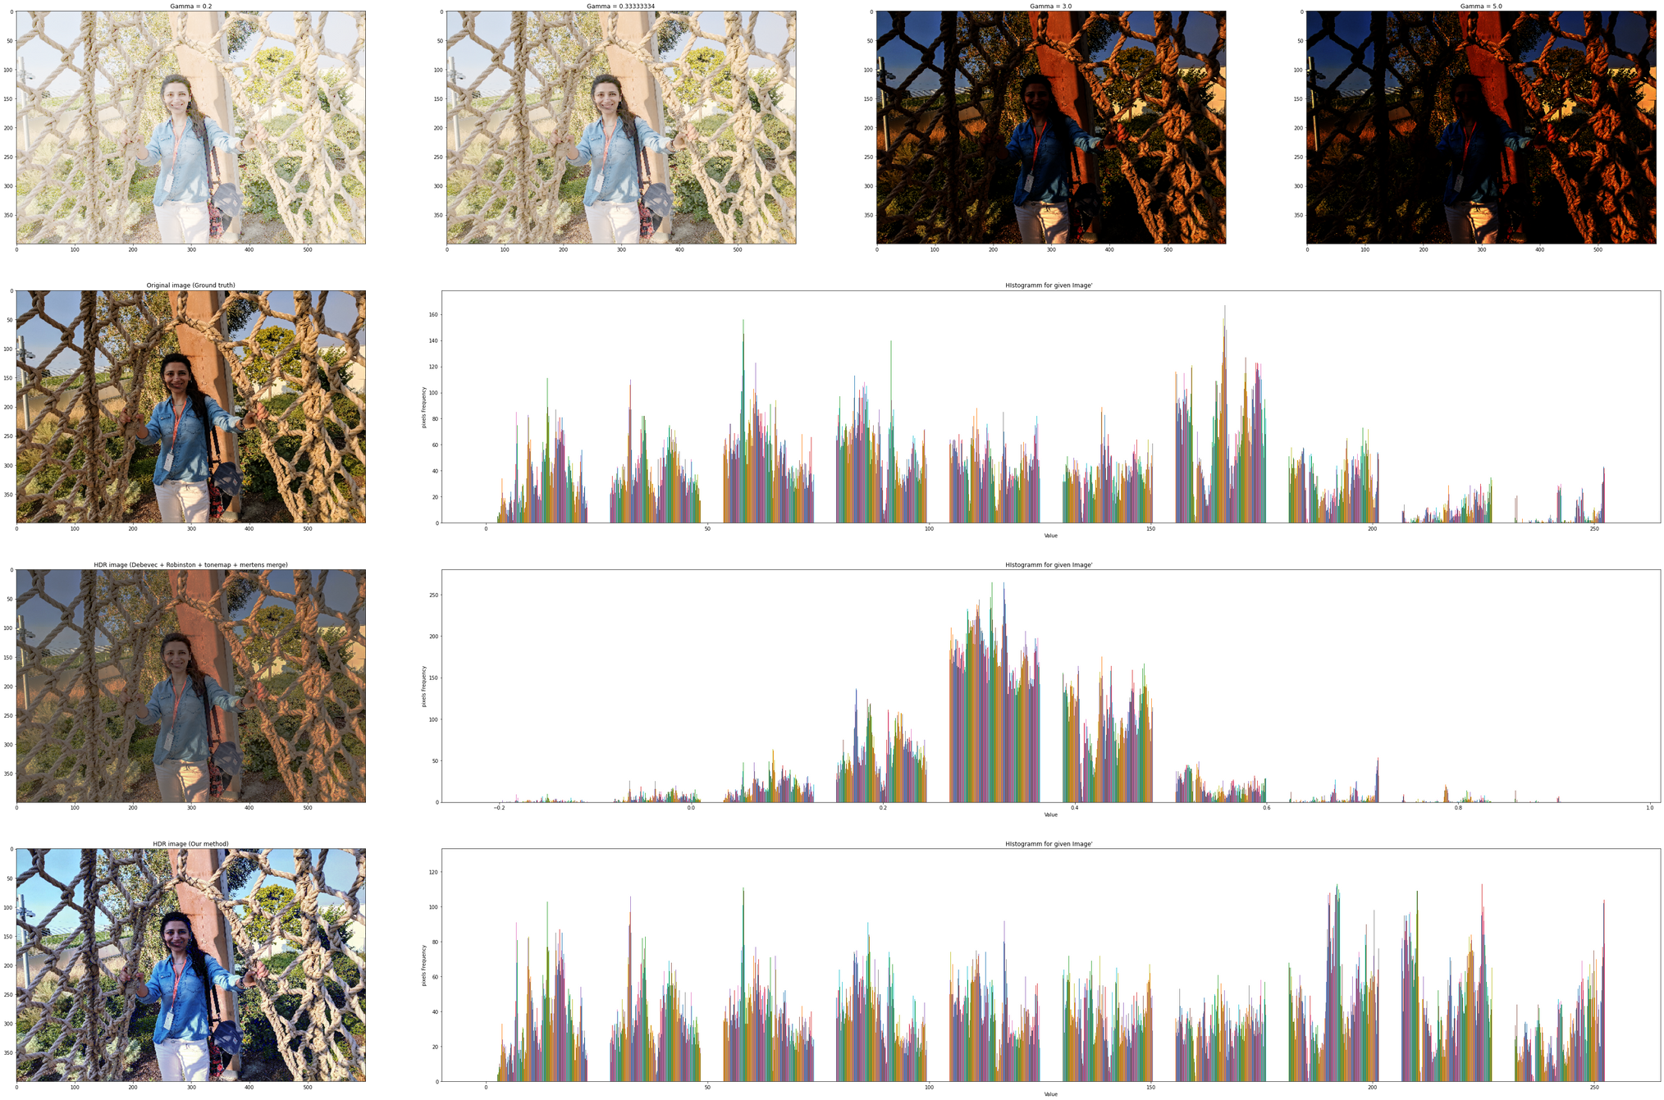
Evaluation with other methods

Slide 24
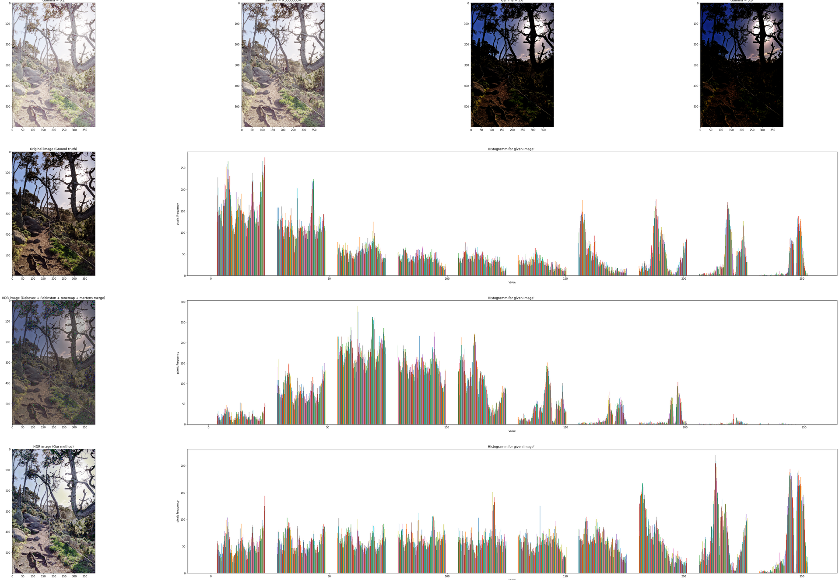
Evaluation with other methods

Slide 25
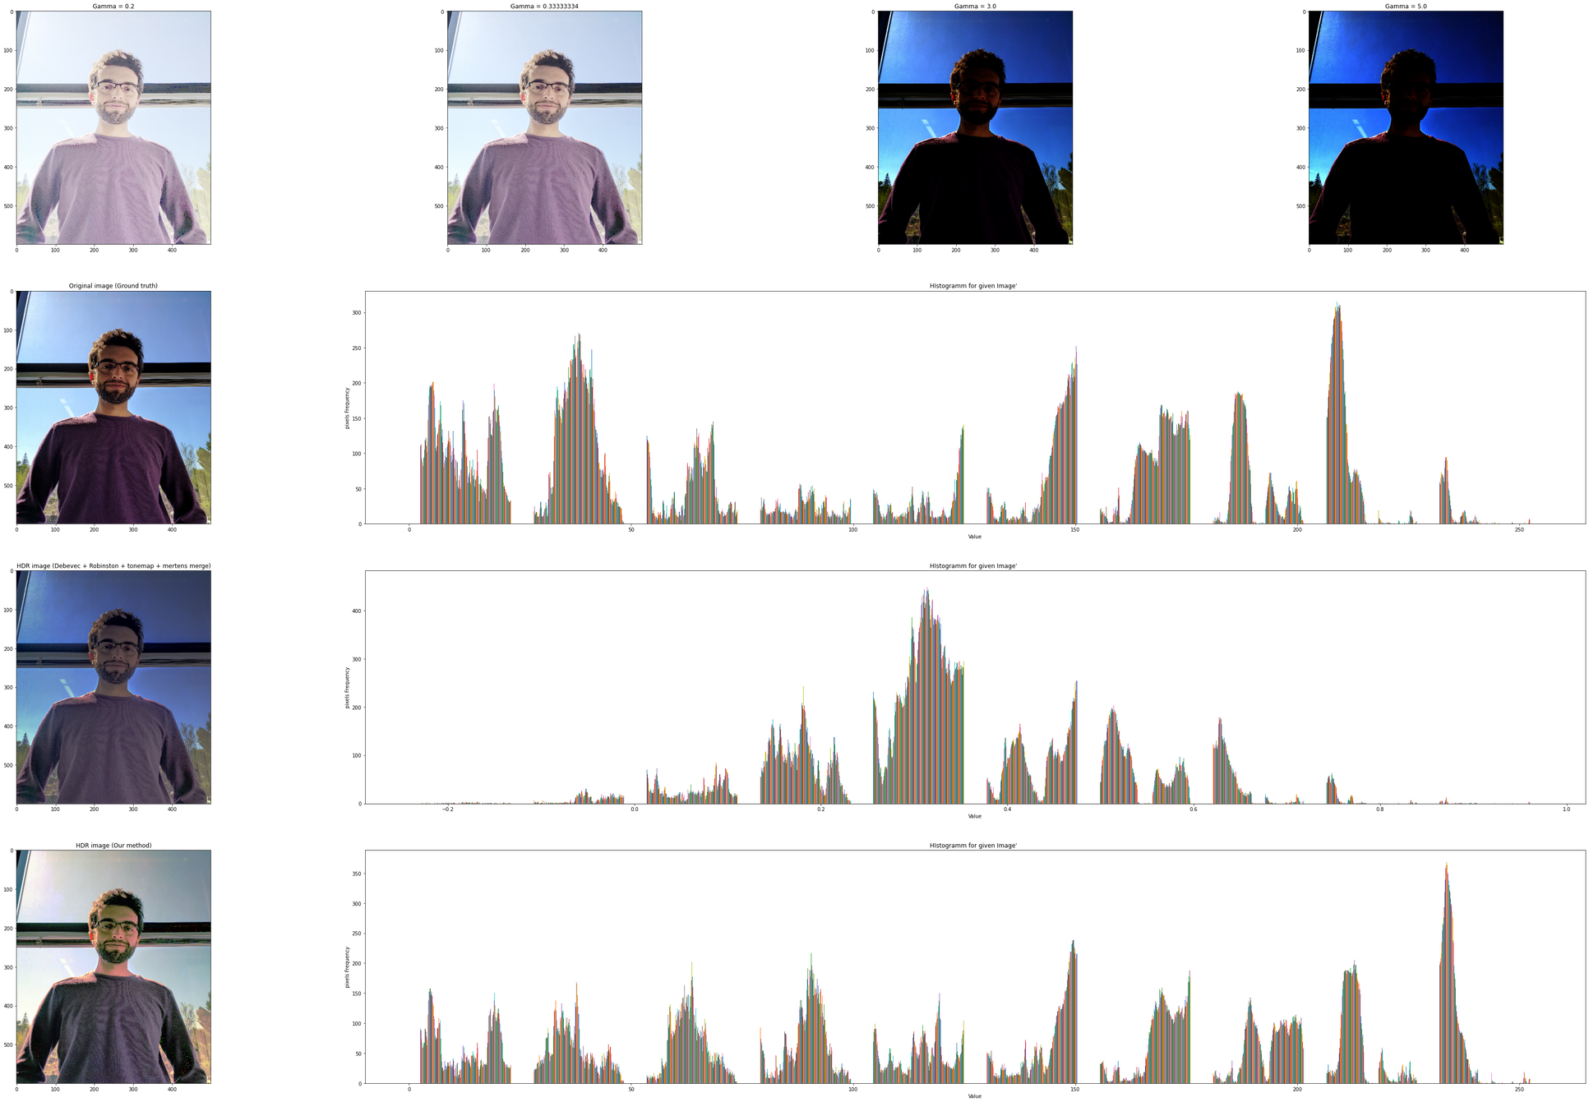
Evaluation with other methods

Slide 26
Reference
Dataset: https://www.hdrplusdata.org/
https://arxiv.org/abs/2106.01439 https://learnopencv.com/high-dynamic-range-hdr-imaging-using-opencv-cpp-python/
Debevec method: http://www.pauldebevec.com/Research/HDR/debevec-siggraph97.pdf Robertson method: https://resources.mpi-inf.mpg.de/tmo/EG05_HDRTutorial_Complete.pdf Mertens fusion: https://www.researchgate.net/publication/4295602_Exposure_Fusion Reinhard Tonemap: https://www.cl.cam.ac.uk/~rkm38/pdfs/mantiuk08datm.pdf
https://resources.mpi-inf.mpg.de/tmo/EG05_HDRTutorial_Complete.pdf

Slide 27
THANK YOU!!!

